Slide 1
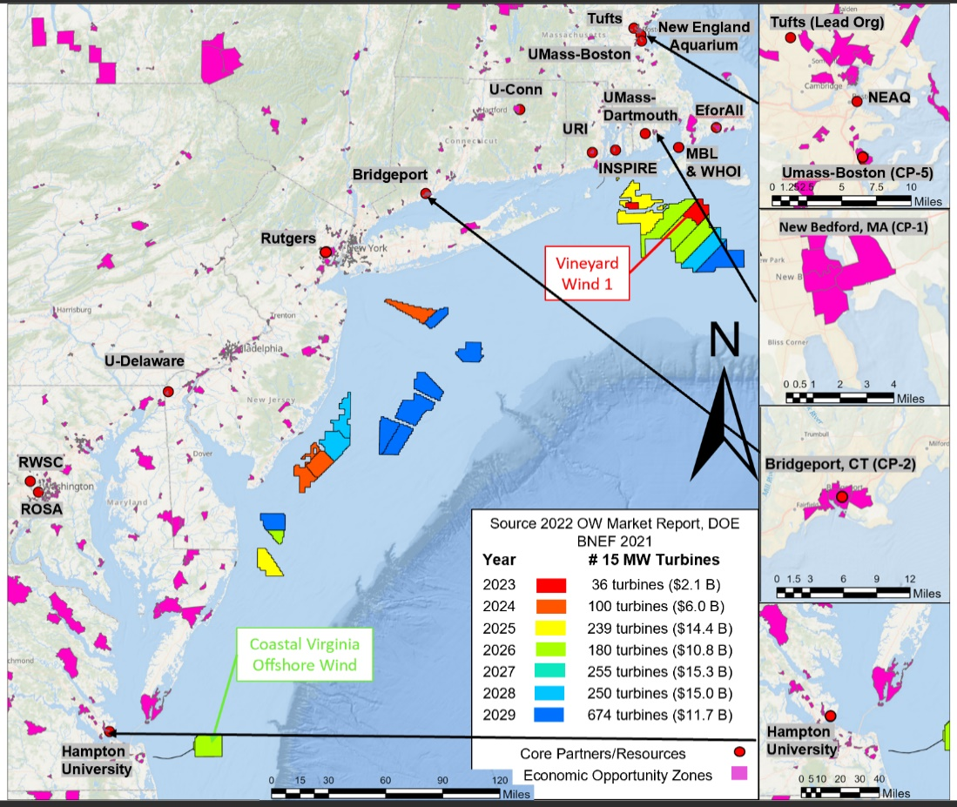

https://m-ocean.org
MOCEAN – Nature Inclusive Offshore Wind Farms
For Healthy Oceans, Thriving Communities, & Energy Justice
Overview of Engine Region and Key Partners
Engine Purpose and Region: Our nation is at the cusp of the large-scale development of offshore wind energy farms. The vast majority of the development over the next decade (>30 GW; a $120B investment) will be in the region presented in the figure below (Engine’s region). This development will be the most significant challenge and opportunity for effective management and use of our coastal oceans in a generation, and we are not prepared for this. We lack the needed workforce, research communities, data sources, methods for learning, convergent activities, policies, and the system-level approach needed for responsible large-scale development. MOCEAN (our Engine) will create an offshore wind research, innovation, economic, and justice-centric ecosystem that creates resilient and healthy oceans, a broad-based new blue economy, thriving coastal communities, and accelerates energy justice. Through this, MOCEAN will maximize the acceptable level of responsible offshore wind development and thereby its contributions to reducing the nation’s CO2e emissions.
Installations by 2029-31
Engine Region Description
Overall region defined by location of offshore wind lease areas and adjacent communities
The colored regions in the water are the wind lease areas, and the legend identifies the estimated number of turbines (if 15-MW) to be installed each year
Pink land area are low-income zones
Convergence Project Hubs in New Bedford MA, Bridgeport CT, NJ, and Hampton VA
Emphasis in first 2 years are sub-regions where wind farms are being constructed
Initial Core Partners
Bristol Community College (BCC) – Workforce
EforAll – Entraprenureship for all (DEIA focus)
Inspire Environmental – Habitat Monitoring
Florida Institute of Tech. (FIT) – Asset Mgnt.
Hampton Univ. – Marine Habitats
Marine Biological Lab. (MBL) – Artificial Reefs
New England Aquarium – Science & Outreach
Regional Wildlife Science Collaborative (RWSC)
Responsible Offshore Science Alliance (ROSA)
Rutgers University – New Blue Economy
SeaAhead – Bluetech Innovation
Tufts University – Foundations
Univ. of Connecticut (U-Conn) – New Blue Economy
Univ. of Delaware – New Blue Economy
Univ. of Mass.-Boston (UMB) – Workforce
Univ. of Mass.-Dartmouth (UMD) – Fisheries, SCoE
Univ. of Rhode Island (URI) – Foundations
Woods Hole Oceanographic Inst.– Ocean Science
For more info: contact dan.kuchma@tufts.edu

Slide 2
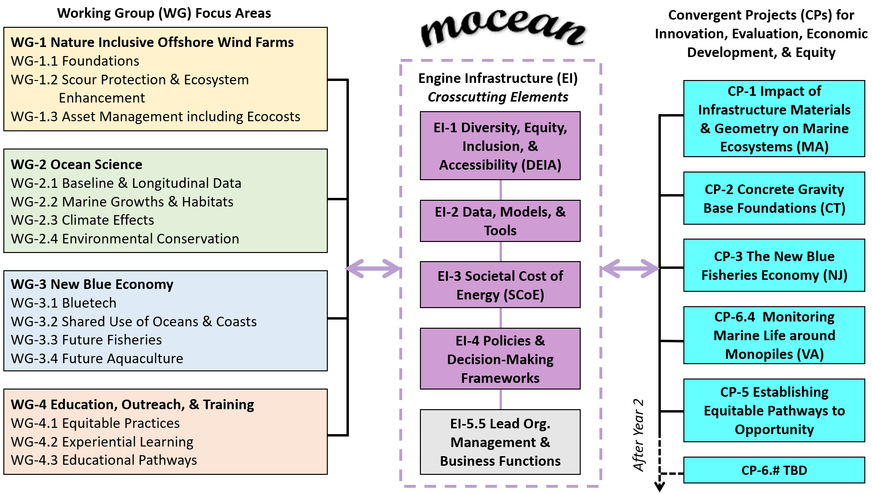
https://m-ocean.org
Nature Inclusive Offshore Wind Farms
Framework & Engine Activities
Engine Structure: The activities of the Engine are presented in the figure below, and they consist of Working Groups (WGs), Convergent Projects (CPs), and crosscutting services (Engine Infrastructure, EI). The members for the WGs will be from research, education, industry, investment, regulatory, non-profit, and stakeholder communities. They will examine and discuss existing needs, resources, and opportunities to help inform ongoing CPs, identify objectives for new CPs, and define requirements for EI services. They will also coordinate MOCEAN’s work with relevant national and international work in related areas and help establish best industry and research practices. The majority of the Engine’s funding in the first two years (all that is part of the initial budget) will be in support of the CPs that bring together the WG activities across the five Convergent Projects (CPs); these are distributed across the Engine’s region in places where new economic development opportunities are greatly needed. The WGs will set the research agenda for years 3-10 when additional partners will be added to MOCEAN and supported by the increased funding that starts in year 3. The crosscutting Engine Infrastructure (EI) services are shown in the middle of the figure below.
Description of Convergent Projects
CP-1: This will involve the fabrication, extensive instrumentation, installation, and monitoring of small structures placed on the seabed off coastal New Bedford, the Woods Hole Research Docks, the Air Sea Interaction tower that is located south of Martha’s Vineyard, and other locations down the coastline in the Engine’s region. This will advance ocean science, and the impact of engineered materials and geometry on marine ecosystems and habitats.
CP-2: This will involve the design of concrete gravity base foundations for offshore wind turbines that can serve as long-lasting and future proof infrastructure, and a proper cost-benefit comparison of different types of foundations.
CP-3: This will focus on the development of ecological products based on existing observations and data assimilative ocean models through the integration of new statistical frameworks. These new tools will serve future fisher communities in a shared-use with offshore wind energy farms.
CP-4: This will study the development of marine ecosystems and habitats on the two monopiles that are located off the Virginia coastline. This builds upon initial and very promising observations on the benefits to marine ecosystems. It will also evaluate and progress bluetech innovations for understanding ocean habitats.
CP-5: This is the development and piloting of specific new EOT activities for a just energy transition.

